Slide 1
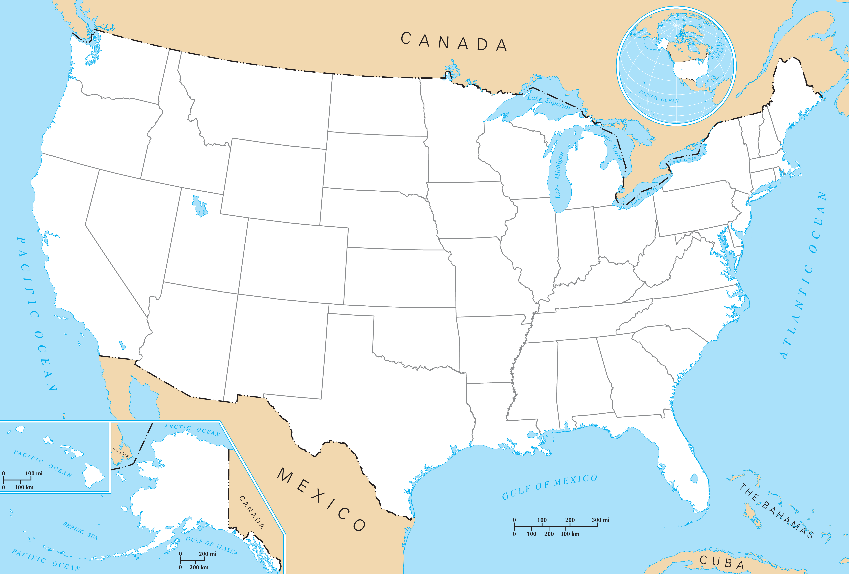
Computer Science 1D Baseball Stadium Graph
For Project 2
This PowerPoint has many elements. Stay on this slide for a bit to allow everything to load.

Slide 2
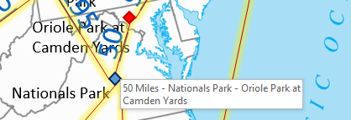

How To Use This Graph
To fully utilize this graph, run this PowerPoint slideshow
All elements of the graph have screen tips, so mouse over an element of the graph if clarification is needed
Click on the BLUE EDGE numbers to color them purple
You can use this feature to mark edges you have already recorded into your program
The graph is undirected
Distances are approximate
Stadium locations are not accurate
Locations have been altered for graph visual clarity
Blue stadiums have National League teams
Red stadiums have American League teams
Here is an example mouse over screen tip:

Slide 3
Additional Tips
If further visual clarity is needed, different elements can be hidden/shown
Click on the “HOME” tab
In the “Editing” section, click “Select”
Click on “Selection Pane…”
Advance one slide
Click on the eyes to hide/show graph elements
To make the graph less cluttered, it is recommended to hide all stadium labels at the bottom of the list since the screen tips give the same information anyway
The graph is high resolution, so zooming can be helpful

Slide 4

Safeco Field
1390
2070
680
300
430
Target Field
430
Rogers Centre
Fenway Park
465
Miller Park
210
225
195
80
Yankee Stadium
50
90
315
80
1500
240
Comerica Park
115
50
Citi Field
Wrigley Field
90
Progressive Field
PNC Park
Citizens Bank Park
AT&T Park
U.S. Cellular Field
250
225
260
195
50
415
Oriole Park at Camden Yards
O.co Coliseum
Coors Field
560
50
235
310
340
Great American Ballpark
Kauffman Stadium
Busch Stadium
Nationals Park
650
830
Dodger Stadium
50
580
650
460
560
930
Angel Stadium of Anaheim
110
375
1255
Petco Park
300
680
Chase Field
870
740
Turner Field
790
Globe Life Park in Arlington
1115
230
600
Minute Maid Park
790
Stadium locations are optimized for edge clarity.
Stadium locations are not accurate, but approximate.
Tropicana Field
210
965
Marlins Park
Drawn by Xavier Lian
CS1D Spring 2016

